Slide 1
How to leverage 2D display in the Azure Portal to achieve more

Slide 2
User Journey
Creation time
New creation
Select an anchor
root anchor point : tenant
Other anchor points : management group or subscriptions or resource group
Pick diagram template from catalog or create new empty
Construct Diagram
From catalog, pick & review
From new empty :
Drag & drop items from Catalog of Azure components + custom items
Create network links
Fill in asked ARM template field for the new ARM resources
Once deployed, a duplicate of the diagram should be saved as a monitoring diagram (that can refer to the actual instances deployed)
Notes:
Step 3 like logic apps wizard experience
4,2 look at network watcher / topology view to check

Slide 3
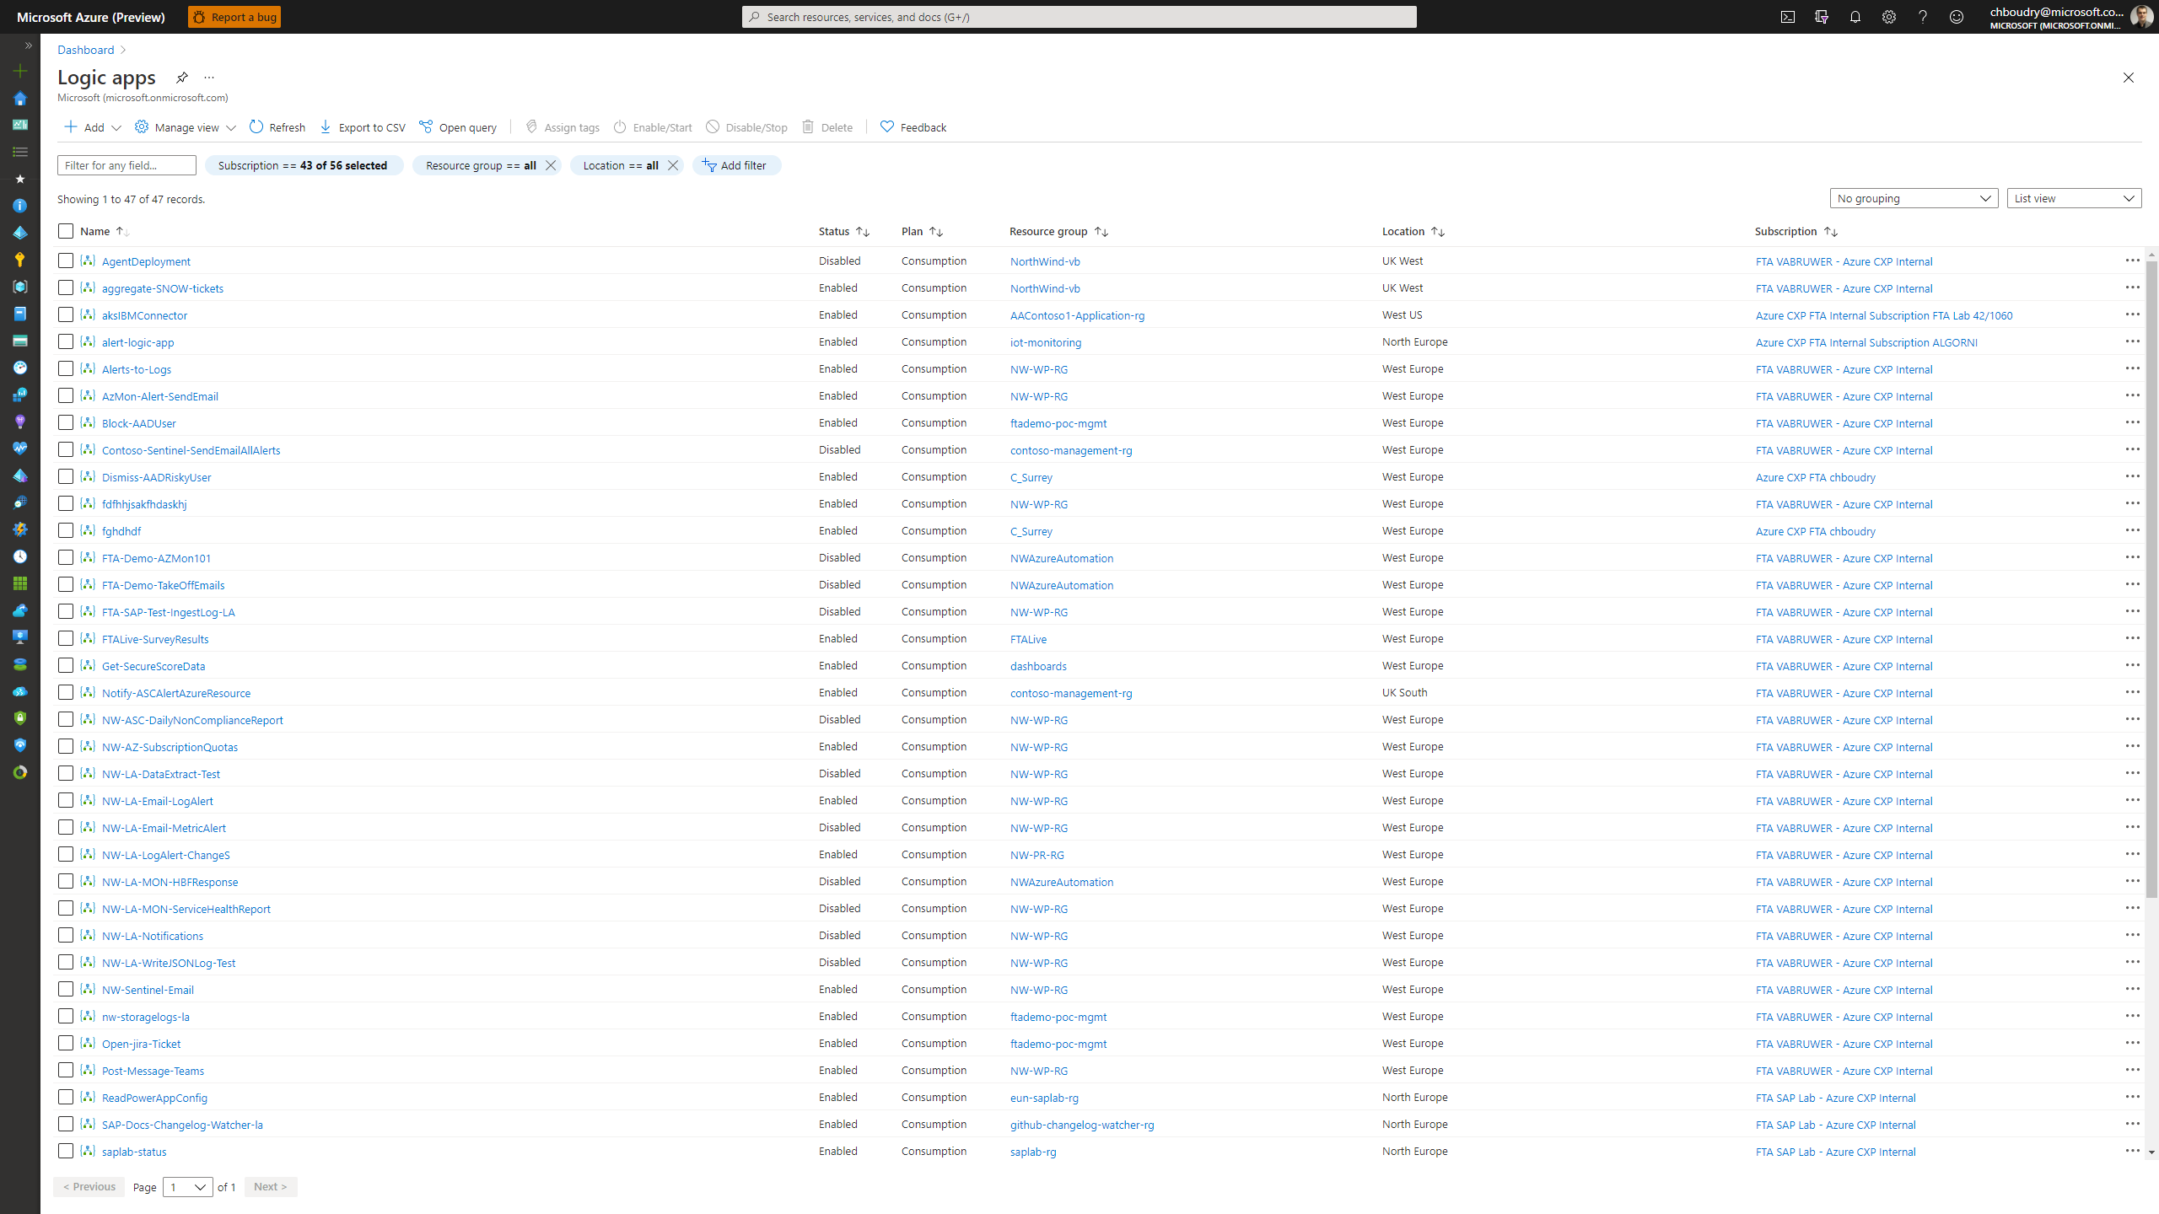

Visual intelligence

Slide 4
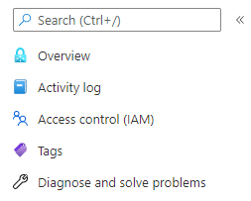




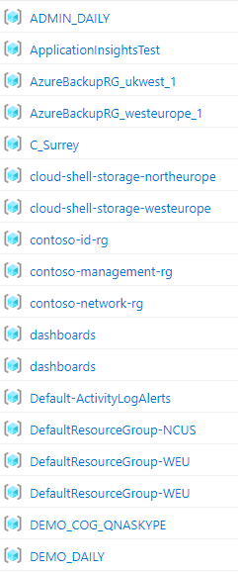
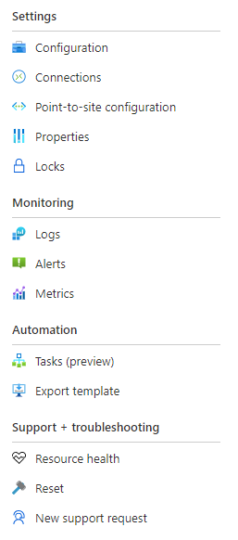








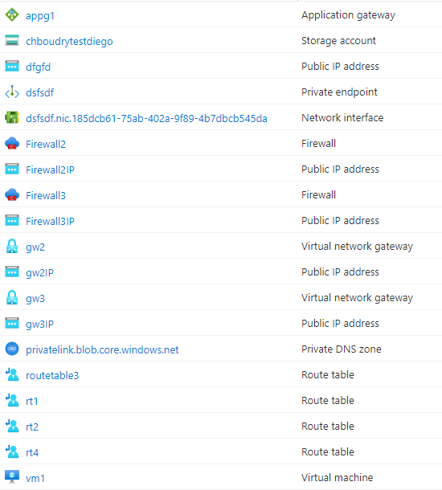



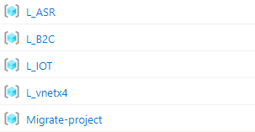
Design
Visual Intelligence
Visualisation
Display
Recommandations
Save
Export
Resource Name
Resource Type
Custom Annotation
Legend
Azure Advisor
Azure Monitor
Azure Policy
Azure Security Center
Custom Recommandation
Network Analysis
Design
Configuration
Display
!
!
12
3
!
!
12
3
!
1
!
Defined Link
Defined Link – Traffic Observed
Undefined Link – Traffic Observed
Legend

